Slide 1
Big Blue Parking Genie
Group 7
Nate Merrill – Backend Developer
Jay Peterson – Database Designer
Alex Thurston – Frontend Developer, Project Manager

Slide 2
Requirement 1.1 – User Authentication
1. User Authentication and Access
1.1. The system must require all users to authenticate themselves before giving them access to the system.
1.1.1. On first login, the system must allow the user to create an account with a username and password.
1.1.1.1. The system must get the user’s email address during account creation
1.1.2. On subsequent login, the system must allow users to enter their username and password. If entered correctly, the user must be given access to the system. If entered incorrectly, the system must allow the user to try again.
MOSCOW – Using a login screen is a must. Users should be authenticated to ensure security.
Every user interfaces with the login screen. Without it, the application cannot be used properly.
This is a FURPS functional requirement. In order to use any other function, a user must be logged in.

Slide 3
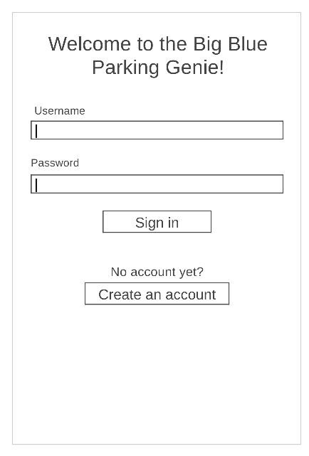
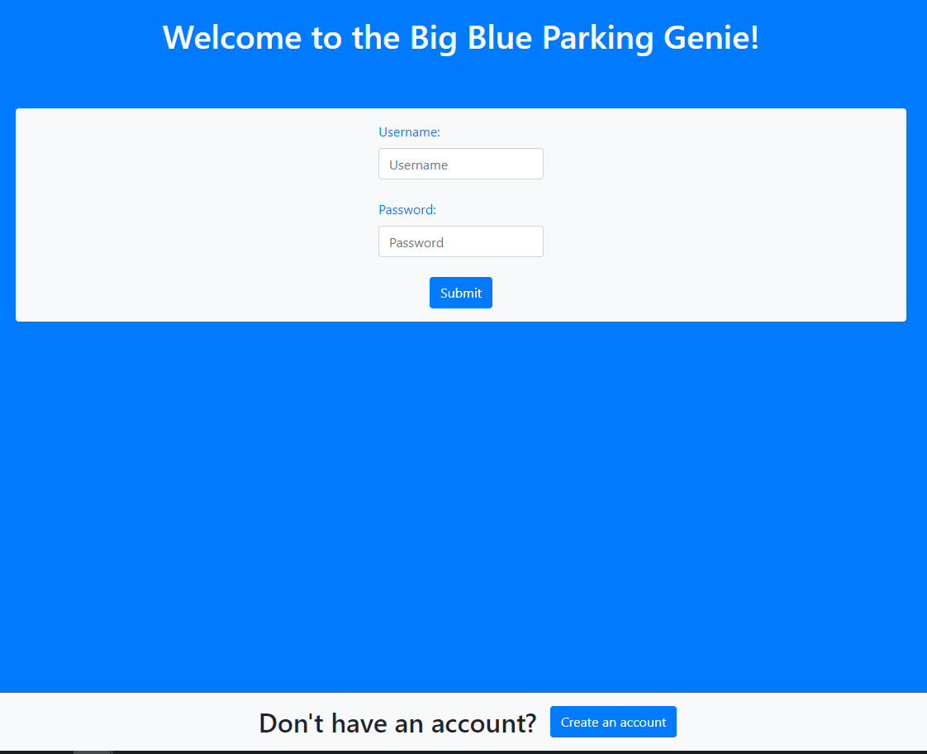
Requirement 1.1 – UX Design
Design by Alex Thurston.
Simpler is better. Users only need to use two text fields and one button to login. A separate button to create an account is kept low to not confuse.
We thought of adding a “forgot password” button. It would send an email with reset instructions but became a “could” function.
Using the @login_required Django decorator, users must be logged in to visit any other page. Any attempt at doing so will redirect to the login URL.

Slide 4
Requirement 1.1 – Scrum history
User authentication is taken care of by Django. We just needed to learn Django’s built-in functionality to accomplish this. Researched by Nate and Jay.
Instead of using a “Create Account” page, we were going to have the user create an account on first log in. It was easier to use a “Create Account” button and we realized it would cause less confusion.
Once Alex had the bootstrap design implemented, we could see more clearly how the login and account creation process would work. They became two simple forms that any user could easily understand.
Our original table that stored user information changed drastically once we realized that Django has a built-in User object that stores information like first_name, last_name, email, and so on. Nate created a Profile model that added more user information like supervisor status and balance.
Nate implemented the Django decorator that keeps unauthorized users from accessing URLs without being logged in. This is used on every single URL except for the sign in and account creation URLs.

Slide 5
Requirement 1.1 – Testing
This can be tested by creating an account and then logging in. You will be taken to the home page if successful. Errors are easily seen if the account creation or login attempt fails.
You can create a superuser account and login to the built-in Django admin page by visiting http://127.0.0.1:8000/admin. You can view all the users and their info, including your own.
In bash, you can run “$ python manage.py test” to run a unit test which will create and verify a temporary account. This account will be destroyed once the test is completed successfully.

Slide 6
Requirement 3.2 – parking Reservations
3.2. The system will allow users with Customer rights (hereafter referred to as “Customers”) to browse, reserve, and pay for parking spaces.
3.2.1. The system will allow Customers to select an event from a list. When the Customer selects an event, the system will display a list of available parking spaces.
3.2.1.1. The system will display the address, distance from event location, type, and price of the available parking spaces to the Customer.
3.2.2. Customers will be able to select a parking space from the list to rent. 3.2.3. If a Customer decides to rent a parking space, the system will require the Customer to pay for the parking space immediately.
3.2.3.1. Customers pay for parking from their preloaded account balance

Slide 7
Requirement 3.2 – Requirement analysis
MOSCOW – Must. This requirement was central to the application’s function and was therefore labeled a ‘must.’
Audience-Oriented – User Requirement. This requirement falls into the User category because this is a function almost all users will need.
FURPS – Functionality. This is a core functional requirement that fits best under ‘Functionality.’

Slide 8
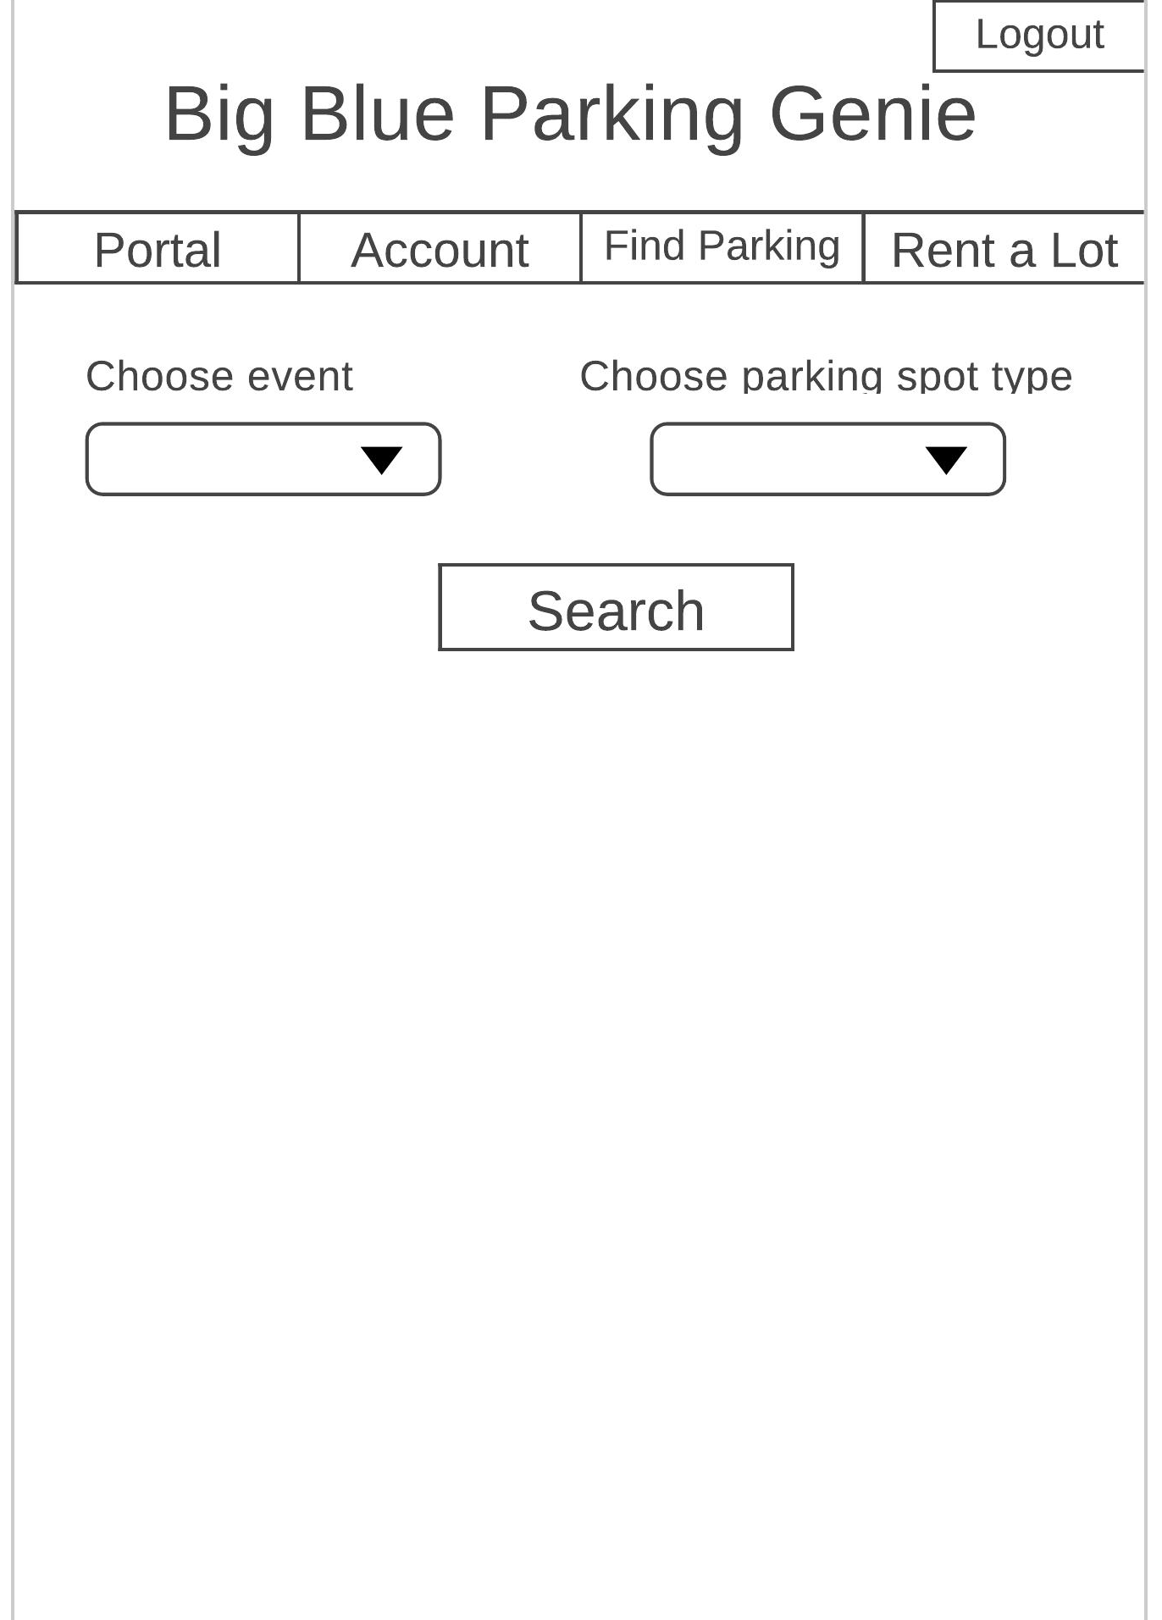
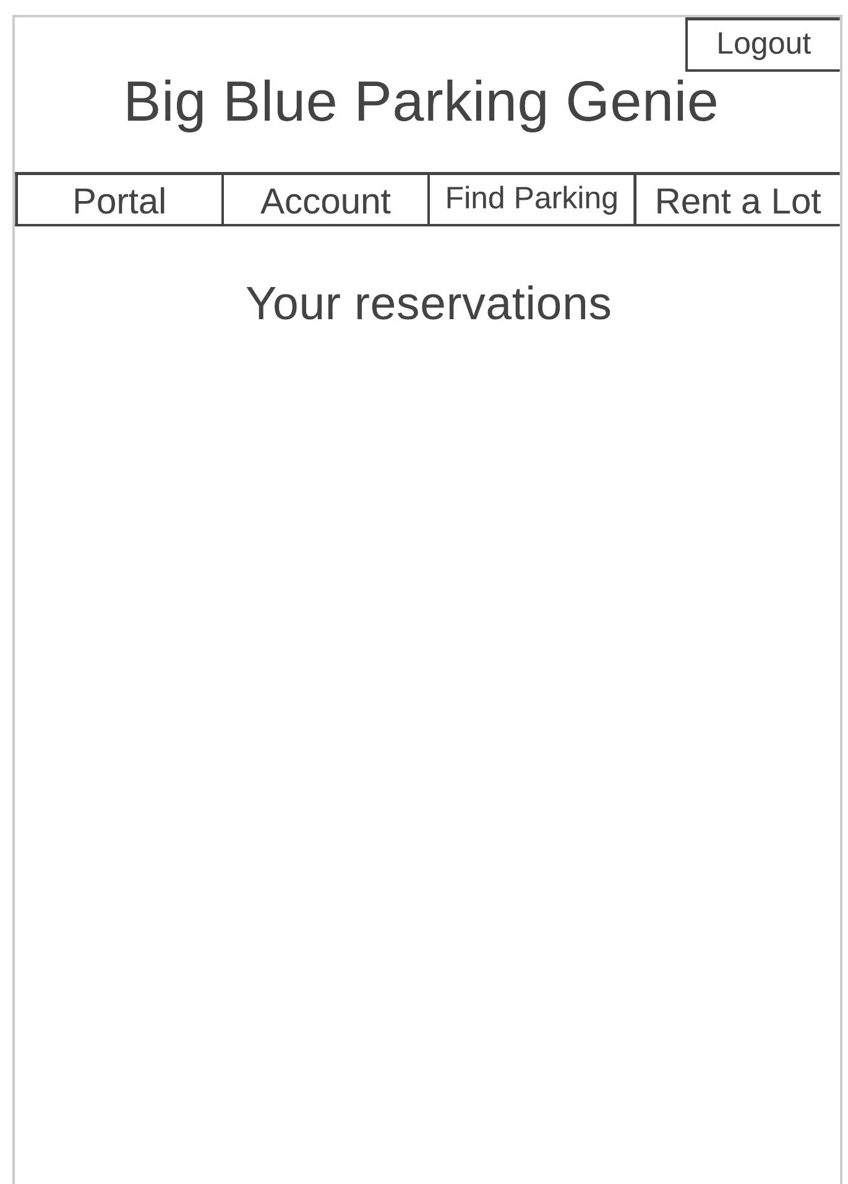
Requirement 3.2 – modeling/Design choices
We decided to filter by event and spot type to make it easier to implement database queries specific to the customer’s needs.
After purchase, we decided to display reservation information on the home screen instead of in the reservations tab in order to simplify and minimize effort on the behalf of the customer.
If a customer does not have enough funds in their account, they are alerted of the issue and asked to resolve it using our “Account” tab.
All information pertinent to purchase (distance, type, location, price) are provided beforehand to minimize customer confusion and possibility of cancellation.

Slide 9
Requirement 3.2 – Scrum History
Parking Reservation Brainstorming – Nate, Jay, and Alex
Team had a group brainstorming session to decide how to implement this feature.
Parking Reservation User Interface – Alex
Alex set up the user interface, with an HTML from to return the data and Bootstrap to style the input and output.
Parking Reservation Functionality – Nate
Nate headed up the main functionality by creating a view function to handle user input, query the database efficiently, display parking choices, and handle user reservation selection.

Slide 10
Requirement 3.2 – Testing
To test this feature, create an account and log in. Navigate to the Find Parking page where you will be able to select an event and spot type to query the system.
Upon submission, a list of available parking options matching the query will appear with information about pricing, spot type, location, and distance from the selected event.
Selecting one of these options will immediately pay for and reserve the parking spot selected for the event specified.
Information concerning the reservation will be listed on the home page of the application for easy access during check-in.
There are pre-populated lots and events so there is no need to list a lot or create an event to test this feature.

Slide 11
Requirement 5.3 – requirement analysis
5.3. Lot Attendants must be able to check Customers in using the Customers’ QR code or access code
5.3.1. The system must give Lot Attendants a way to scan or enter the code to validate that the Customer has rented a parking spot
5.3.1.1. If a QR code is used, Lot Attendants can use a separate QR code scanning app on their phone, but the QR code must link back to the system for confirmation
5.3.2. After validation, the system must display the ID number of the parking spot the Customer has rented so the Lot Attendant can direct the Customer to their parking spot.
MOSCOW – Must. This requirement was central to the application’s function, and was therefore labeled a ‘must.’
Audience oriented – User Requirement. This requirement falls into the User category because this is a function that users who rent out lots will need.
FURPS – Functionality. This is a core functional requirement that fits best under ‘Functionality.’

Slide 12
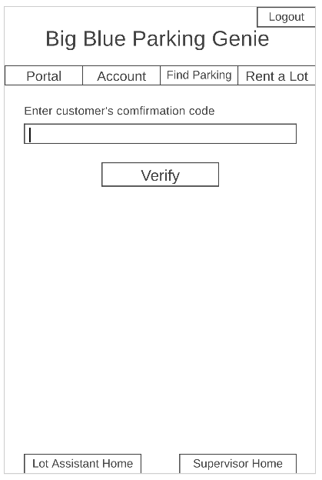
Requirement 5.3 – modeling/design choices
We decided to use a 6-digit numerical code instead of a QR code for the authentication due to ease of implementation and ease of use for both customers and Lot Owners.
Originally, we wanted to have a feature where Lot Owners could authorize other users to be Lot Attendants for them but decided this feature would be in the “could” category. Lot Owners have access to this feature for their own lots.
When a customer makes a parking spot reservation, a random code is generated and stored in the database with the rest of the parking spot reservation info.
This code is displayed on the customer’s home page with the reservation location, name, and date.
Only Lot Owners have access to the screen showed at left. When a customer arrives a lot, the Lot Owner can ask for their code and enter it here.
The system then looks up the customer’s reservation in the database. If the code is valid, the system will display the customer’s name and their parking spot number so the Lot Owner can direct them to their parking spot.
From lo-fi prototype

Slide 13
Requirement 5.3 – Scrum history
Rental Verification Brainstorming – Nate and Jay
We did a brainstorming session after a meeting and decided how we wanted to implement this feature.
Rental Verification User Interface – Alex
Alex set up the user interface for this page, with an HTML form to return the data and Bootstrap to style the input and output.
Rental Verification Database Updates – Nate
The database scheme had to be changed to store a confirmation key with the other parking spot data when a rental was made. This required changes to our view functions and database population migrations.
Rental Verification Functionality – Nate
This is where the UI code and the database code were connected to make this functionality work. A view function was created to handle data from the HTML input form. Inside this function, the database was queried and filtered to show only the desired rental data. This data was then sent back to the template and the page was reloaded to display the data.

Slide 14
Requirement 5.3 – testing
To test this feature, create an account to use as a “Lot Owner.” Log in to this account, navigate to the Manage Lots page, and create a new parking lot. Publish this lot to one of the default events that the database migration prepopulates.
Log out and create another account to serve as the customer. Log in to this account, navigate to the Account Info page, and transfer enough funds into the account to rent a parking spot at the price you set when creating the lot. Go to the Find Parking page, search for the event you published the lot under, and rent a parking spot. You will be redirected to the home page, and should see your rental there, complete with a 6-digit confirmation code. Record this code somewhere.
Log out and log back into to the account you created the parking lot with. Navigate to Lot Attendant Home at the bottom of the page. Enter the confirmation code you got in the input box shown.
The name and parking spot reservation of the customer account will be displayed on the screen.

Slide 15
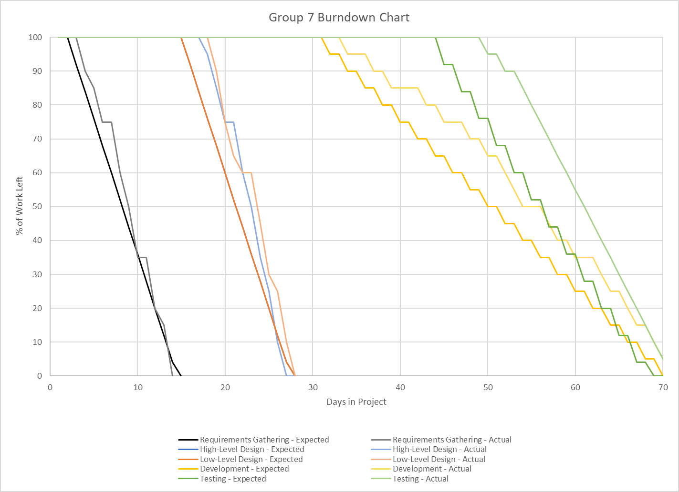
Burndown

Slide 16
Resources
Using the Django authentication system. Django. (n.d.). https://docs.djangoproject.com/en/3.2/topics/auth/default/.
Bootstrap Documentation. Bootstrap. (n.d.). https://getbootstrap.com/docs/5.0/getting-started/introduction/.
User Authentication With Python and Django. Codemy. (n.d.). https://codemy.com/user-authentication-pythong-django/.
Django Testing - Introduction to testing in Django - Django Testing Series Part 1. Youtube. (2020, August 18). https://www.youtube.com/watch?v=swEjbCW9XDY&ab_channel=VeryAcademy.
Using Databases With Django - Django Databases #1. YouTube. (2020, February 3). https://www.youtube.com/watch?v=A1nqCgAM6CE&t=4s&ab_channel=Codemy.com.

Slide 17
Questions?

